Slide 1



Wellcome
To
Ethical Hacking class
2nd Week
Day 1st
Muhammad Bilal

Slide 2

Information Gathering
Definition: Information gathering, or reconnaissance, involves collecting data to understand a target's environment. This includes technical details like IP addresses and software versions, as well as personal information.
Purpose:
1. Identify Vulnerabilities: Find security weaknesses that can be exploited.
2. Understand Target Infrastructure: Learn about the target's network, systems, and technology.
3. Prepare for Social Engineering: Collect information for social engineering attacks like phishing.
4. Legal and Regulatory Compliance: Ensure data collection methods follow legal and regulatory standards.
.

Slide 3

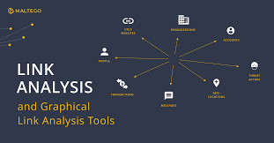


Techniques and Tools for Information Gathering
Shodan
Maltego
The Harvester
Spokeo

Slide 4

Shodan and IoT Device Information
Cyber Security
Definition: Shodan is often called the "search engine for the Internet of Things (IoT)." Unlike traditional search engines that index web pages, Shodan indexes devices connected to the internet. This includes routers, servers, webcams, smart TVs, traffic lights, and more. It gathers data such as IP addresses, open ports, banners, and device types, which can be used to identify and assess security vulnerabilities.
https://www.shodan.io
https://developer.shodan.io/api/introduction
https://www.shodan.io/search/filters
https://cli.shodan.i o/

Slide 5
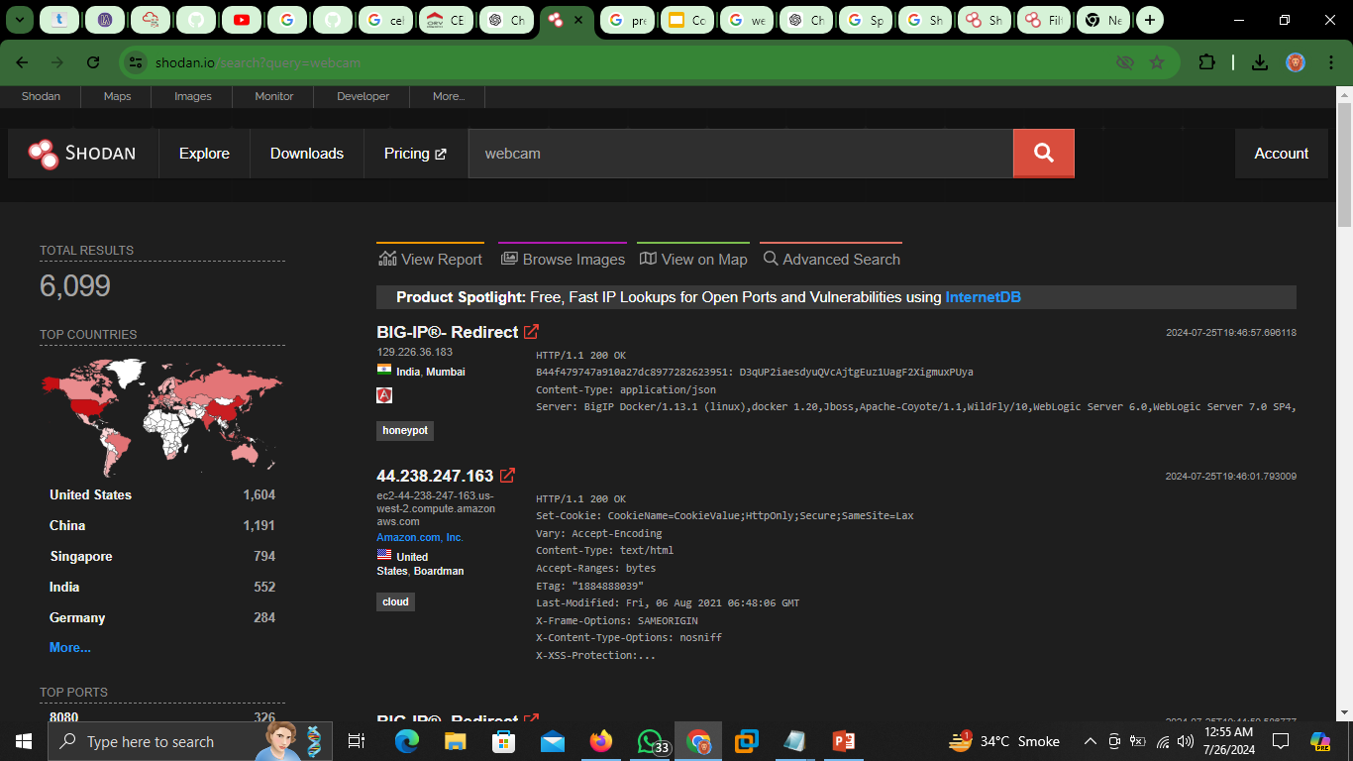
01
Shodan Filters
Techniques and Tools:
02
Shodan Monitor
03
Shodan Maps

Slide 6

Maltego for Data Link Analysis
Definition:
Maltego is a powerful tool used for link analysis and data visualization. It helps users uncover and analyze relationships between different data points, such as people, companies, domains, and networks. By transforming these data points into visual graphs, Maltego allows investigators to see patterns and connections that might not be immediately obvious.
Purpose:
Investigating Cyber Threat Actors
- Scenario: You’re looking into a potential cybercriminal.
- Process: Enter known details (like aliases, emails, or domains) into Maltego.
- Outcome: Maltego shows a visual map of connections, revealing related domains, IP addresses, social media profiles, and links to other members of the network.
Corporate Espionage Investigation
- Scenario: A company suspects someone is leaking internal data.
- Process: Use Maltego to link employees, email addresses, and social media activities.
- Outcome: Maltego may show unexpected connections or patterns, helping identify potential insiders involved in the leaks.

Slide 7
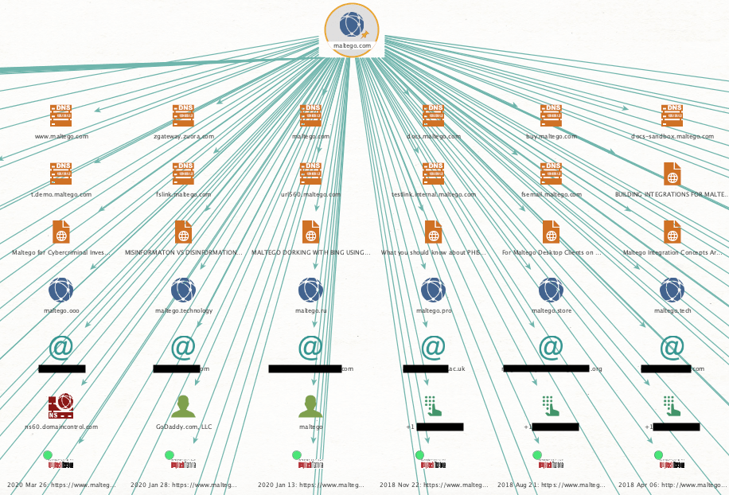
Out Put
Techniques and Tools
Entity Transforms: Maltego uses entities (e.g., person, email address, domain) and transforms (scripts that pull data for those entities) to build visual graphs.
Custom Transforms: Users can create custom transforms to pull data from specific sources relevant to their investigations.
Collaboration: Maltego allows multiple users to collaborate on the same graph, making it ideal for team investigations.
01
02
03
https://www.maltego.com/
https://docs.maltego.com/support/home
https://www.maltego.com/maltego-community/

Slide 8
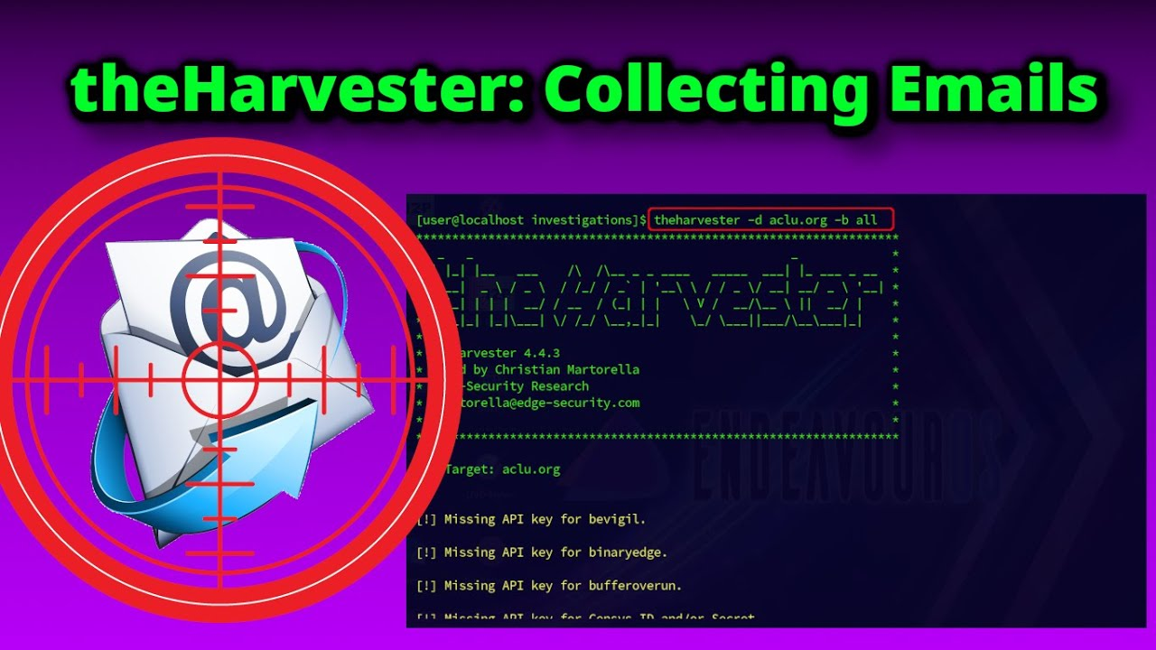
The Harvester for Gathering Emails and Subdomains
Definition: The Harvester is a widely-used reconnaissance tool in cybersecurity. It gathers emails, subdomains, IP addresses, and URLs through search engines and other public sources. This tool is crucial for penetration testers during the information-gathering phase of an assessment, providing a wealth of data that can be used to identify potential entry points into a target system. Gathering Emails for Social Engineering:
Scenario: Security testers want to simulate phishing attacks.
Process: Use The Harvester to collect email addresses from a target domain.
Outcome: The collected email addresses can be used to create realistic phishing campaigns to test the organization's security awareness and email filtering systems.
Enumerating Subdomains for Vulnerability Assessment:
Scenario: Penetration testers are mapping a target’s attack surface.
Process: Run The Harvester to find subdomains of a target domain.
Outcome: Identified subdomains may reveal additional services or applications that could have security vulnerabilities.

Slide 9
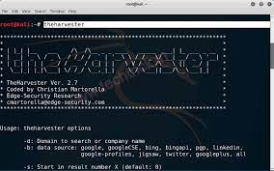
Techniques and Tools
Search Engines Integration: The Harvester queries multiple search engines like Google, Bing, and others to collect data.
Public Data Sources: It can pull data from public repositories such as LinkedIn, PGP key servers, and Shodan.
Output Formats: Data can be output in various formats (XML, JSON, CSV) for further analysis and integration with other tools.
01
https://github.com/laramies/theHarvester
02
#theHarvester –h (Kali Linux Tools: The Harvester)
03
https://github.com/laramies/theHarvester/wiki

Slide 10
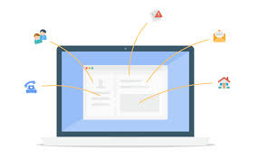
Spokeo and People Search Tools
Definition: Spokeo is a people search engine that aggregates information from a variety of sources to provide detailed profiles on individuals. It compiles data from social media, public records, court records, and other databases. People search tools like Spokeo are commonly used for background checks, finding lost contacts, and verifying identities.
Background Checks for Hiring:
Scenario: Employers need to verify the background of potential hires.
Process: Use Spokeo to search for the candidate’s name, email, or phone number.
Outcome: Spokeo provides a report detailing the candidate’s contact information, employment history, social media profiles, and any criminal records, helping employers make informed decisions.
Reconnecting with Family Members:
Scenario: An individual is trying to find a long-lost relative.
Process: Enter the relative’s name, known addresses, or phone numbers into Spokeo.
Outcome: Spokeo aggregates information from various sources, helping the individual locate and reconnect with their relative.

Slide 11
01
Techniques and Tools:
Search Filters: Spokeo offers filters to narrow down search results based on age, location, and known relatives.
Data Sources: Spokeo aggregates data from various sources, including social media, public records, court records, and marketing databases.
Report Generation: Users can generate detailed reports on individuals, which include comprehensive information from multiple sources.
https://www.spokeo.com/
02
https://www.intelius.com/
03
https://pipl.com/

Slide 12
Thank You!
Happy Hacking.

